Slide 1
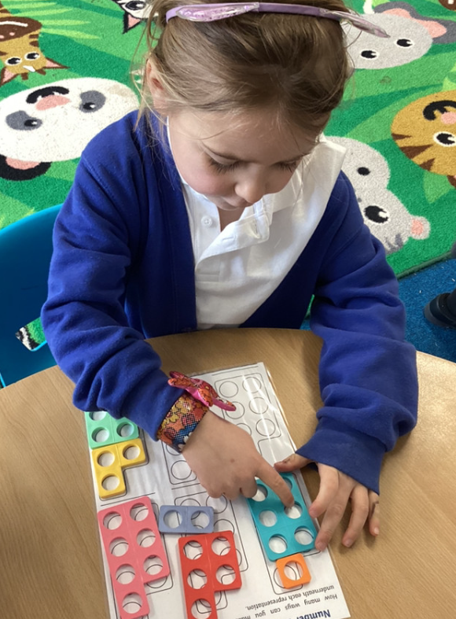
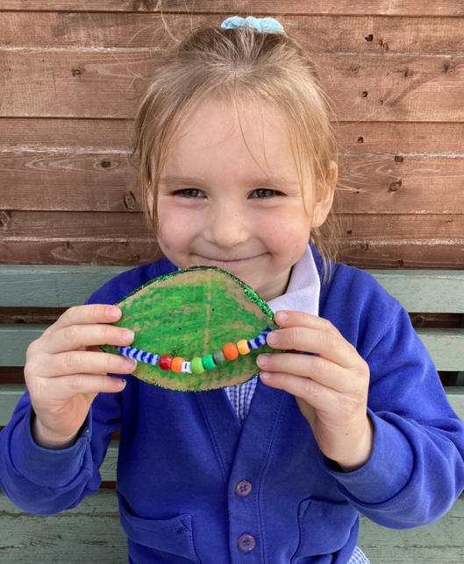
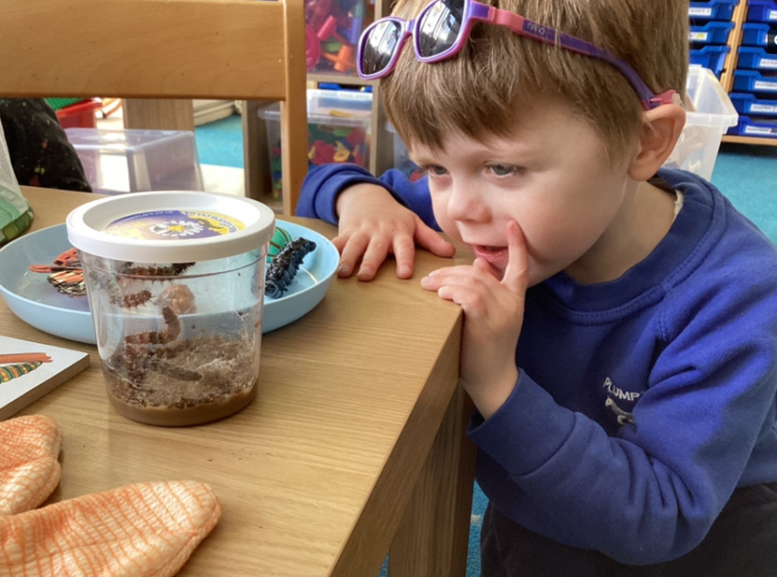
Welcome to Plumpton Primary School
We are kind and outward-looking;
learners today, leaders tomorrow.
Starting School – September 2024

Slide 2
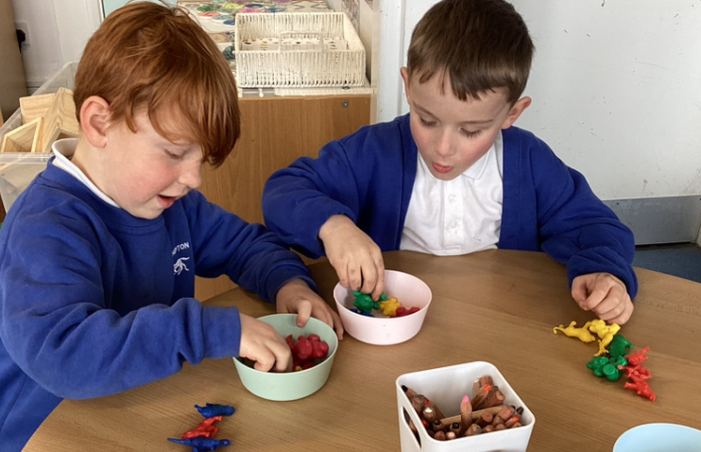
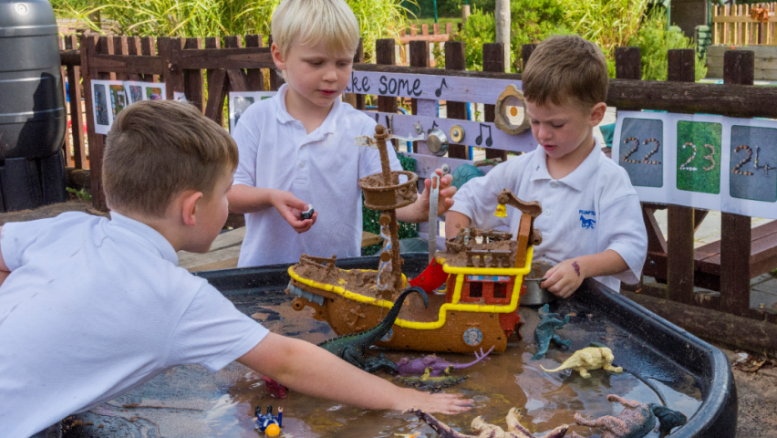
Supporting the Transition to School
Welcome Session
Stay and Play Session
Staggered Start
Handover with Preschool/Nursery
Home Visits
Website Resources

Slide 3
Welcome/Stay and Play Sessions
Please do take this opportunity to come along with your child and explore our learning environment, meet staff and get to know other families.
Home Visits
Home visits provides the opportunity for us to get to know every family individually and find out about your child’s development and interests. These visits will also enable you to ask questions and share information privately before your child starts school.

Slide 4
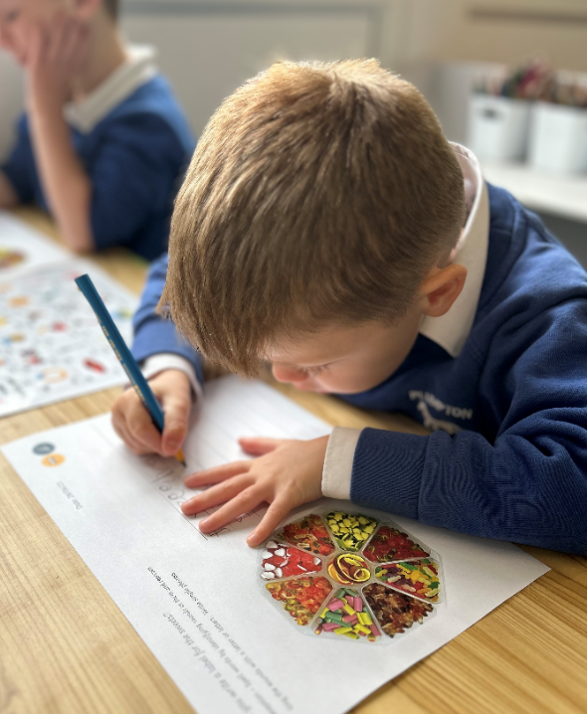
A Positive Start to School
Half day sessions
Small groups
Experience of lunch times
Flexible full time start
Year 6 buddies
Year 1 Robins

Slide 5
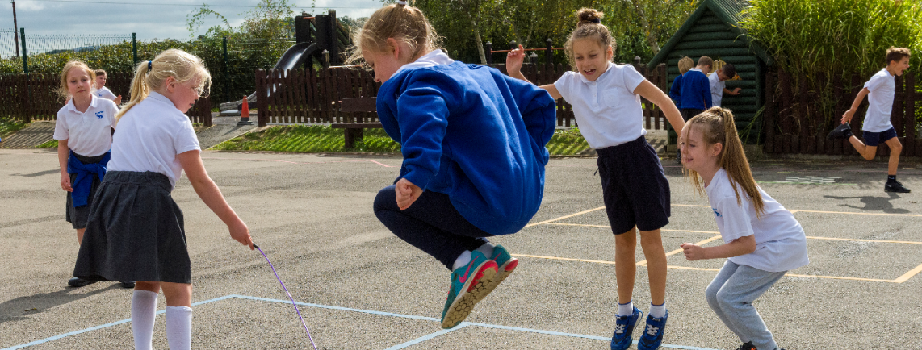
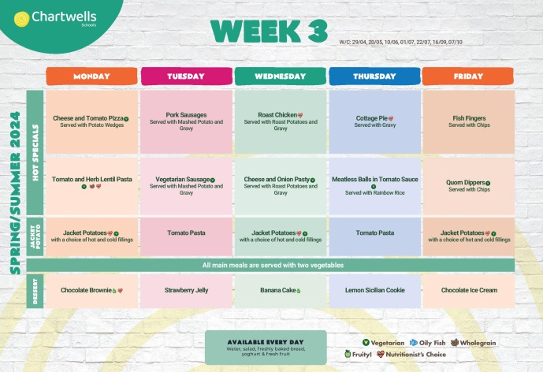
Lunch Time
Free school meals or packed lunch
First two weeks of school – preordered lunch
Buddies and friends will sit together
Robins staff supporting children in the lunch hall

Slide 6
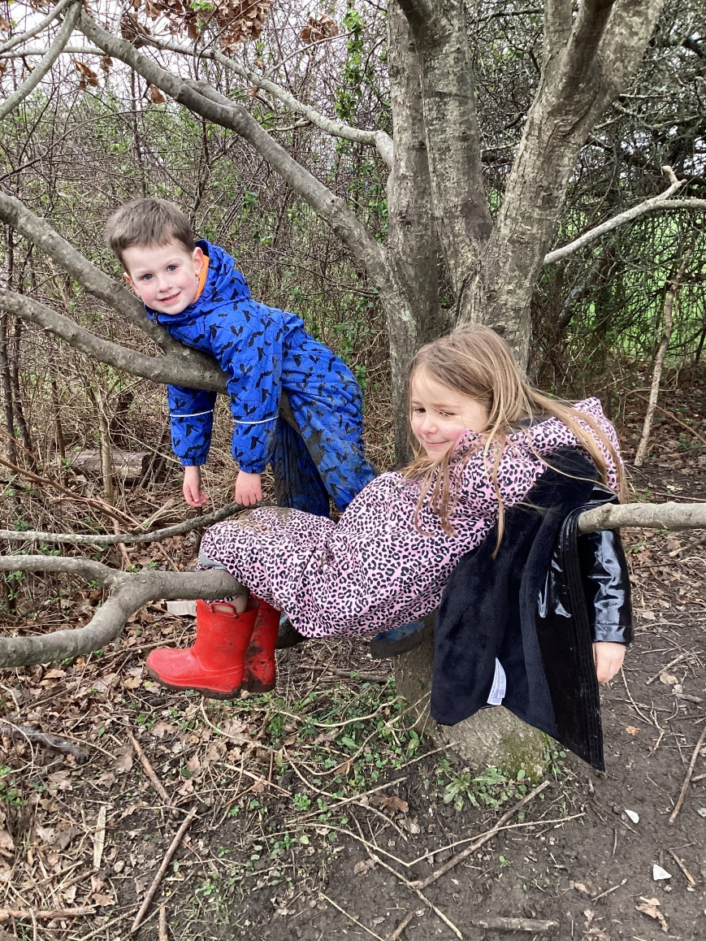
What Do I Need to Prepare?
School uniform
Spare set of clothes
PE kit
Welly boots and waterproofs
Book bag
Water bottle
Snack pot

Slide 7
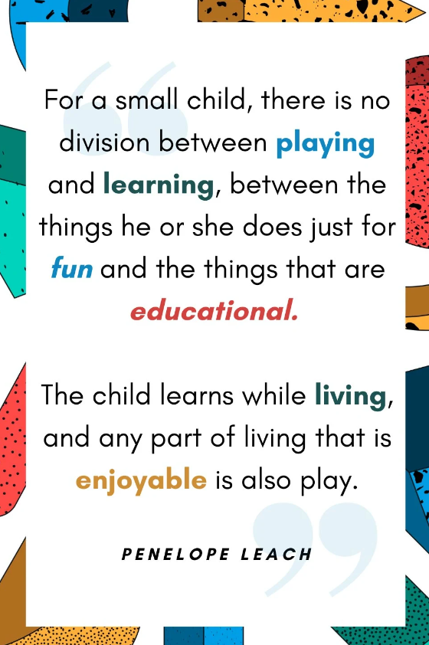
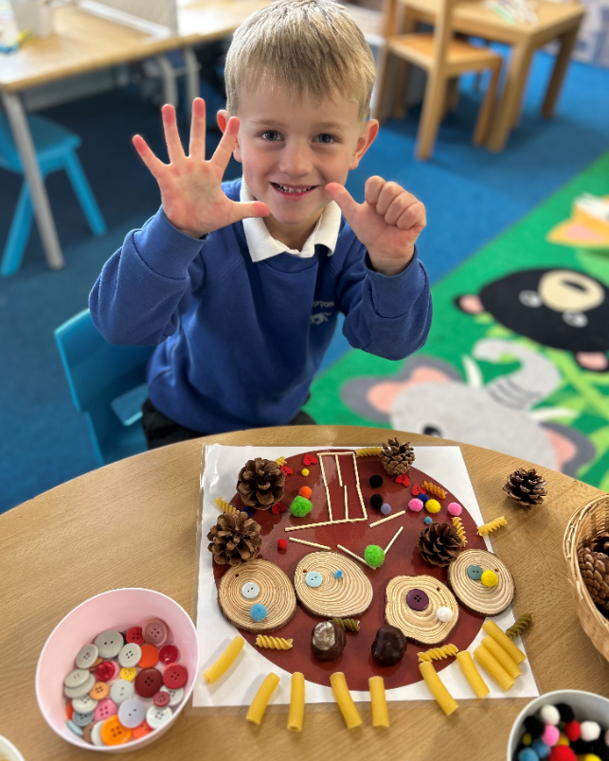
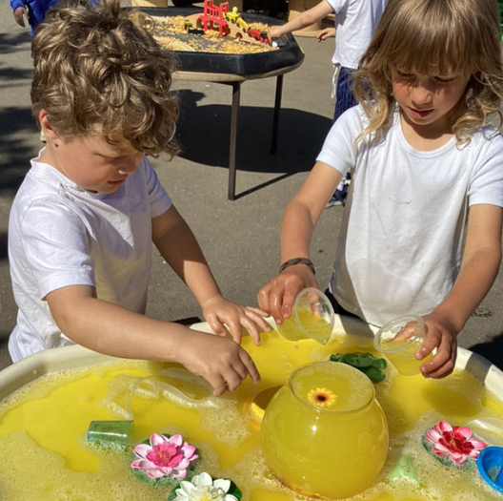
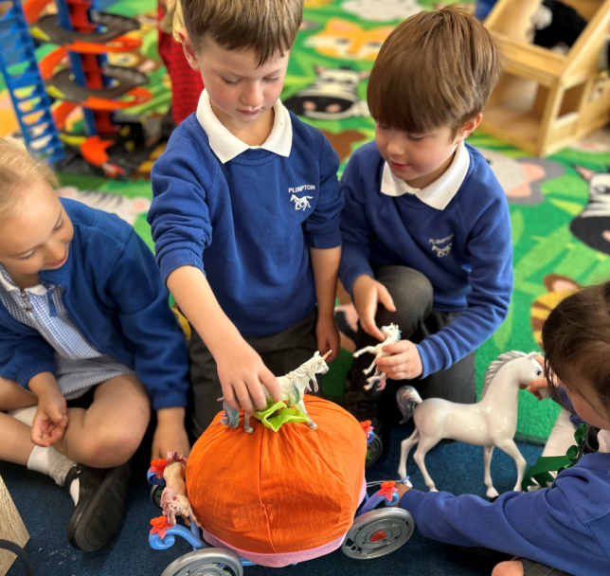
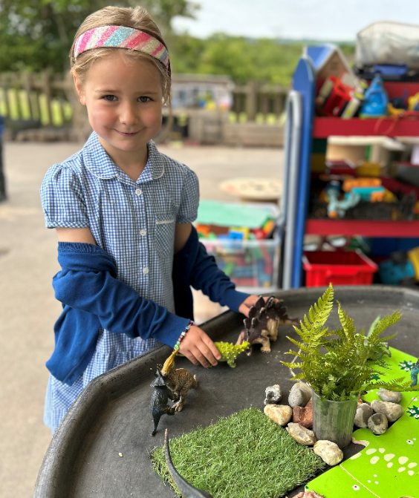
Early Years in Robins

Slide 8
Forest School

